Slide 1
Introduction to c++
Part-2

Slide 2
ASCII(American standard code for information interchange)
Total 256 symbols which include
A-Z
a-z
0-9
Special symbols

Slide 3
A →65 a→ 97 0→48
B→66 b→98 1→49
: : : : : : : : :
Z→90 z→122 9→57
Find the ASCII value of your name. Convert each value into 8bit binary.

Slide 4
Write a program to enter the character and display the ASCII value.
void main()
{
char ch;
int a;
cout<<“ Enter the character :”;
cin>>ch;
a=ch;
cout<<“ The ASCII value of :”<<ch<<“ character is:”<<a;
getch();
}

Slide 5
Write a program to enter the ASCII value from user and display the character.
void main()
{
char ch;
int a;
cout<<“ Enter The ASCII value :”;
cin>>a;
ch=a;
cout<<“The character is:”<<ch;
getch();
}

Slide 6
W.A.P to accept a character from a user and check if it is a digit or not (use conditional operator)
Hint
(ch>=48 && ch<=57)? cout<<“it is a digit “: cout<<“ It is not a digit”;

Slide 7
W.A.P to check if the given character is upper case alphabet or not
Hint
(ch>=65 && ch<=90)? cout<<“it is a upper case “: cout<<“ It is not upper case”;

Slide 8
W.A.P to check if the given character is special character or not.
Hint
(ch>=65 && ch<=90 ||
ch>=97 && ch<=122 ||
ch>=48 && ch<=57)? cout<<“it is not a special character“: cout<<“ It is a special character”;

Slide 9
W.A.P to check if the given number is single digit, double digit or 3-digit number
Hint
(ch>=0 && ch<=9)?cout<<“Single digit”:(ch>=10 && ch<=99) ? Cout<<“Double digit “:(ch>=100 && ch<=999)?cout<<“3 digit”:cout<<“More than 3 digit”;

Slide 10
W.A.P to find the greatest of 3 given numbers
Hint
(a>b && a>c)?cout<<“a is greater”:(b>a && b>c)?cout<<“b is greater”: cout<<“c is greater”;

Slide 11
W.A.P to find the conversion of Fahrenheit into Celsius.
Hint:
c= (5/9)*(F-32);
W.A.P to find the conversion of Celsius into Fahrenheit.

Slide 12
W.A.P to find the Simple interest.
Hint: s=pnr/100;
W.A.P to find the Compound interest.
Hint: A = P ( 1 + r/100 ) ^{t}

Slide 13
W.A.P to generate an employee pay slip (BS- Basic salary)
HRA= 8% of BS
PF=5% of BS
TA = 7% of BS
DA= 16.2% of BS
Tax=10,000
Bonus=8000
Insurance=5000
AL=TA+DA+Bonus+HRA
DED=PF+Tax+Insurance
Net salary= AL+BS-DED

Slide 14
W.A.P to swap two variable values
For eg if a=50 and b=75
Then after swapping
a=75, b=50;
Hint: you can use a third variable

Slide 15
Program Methodology
Problem
Solution
Algorithm
Coding
Debugging
Testing and Validation
Modular program
Characteristics of a good program.

Slide 16
setw and setprecision functions
These functions are available in the header file
iomanip.h
setw→ sets the field width
cout<<setw(10)<<“BGSNPS”;
OUTPUT
cout<<setw(100)<<“BGSNPS”;
OUTPUT
BGSNPS
BGSNPS

Slide 17
setw and setprecisionfunctions
setprecision→ sets the decimal precision
cout<<setprecision(2)<<123.4567;
OUTPUT
cout<<setprecision(3)<<123.45675
OUTPUT
123.45
123.456

Slide 18
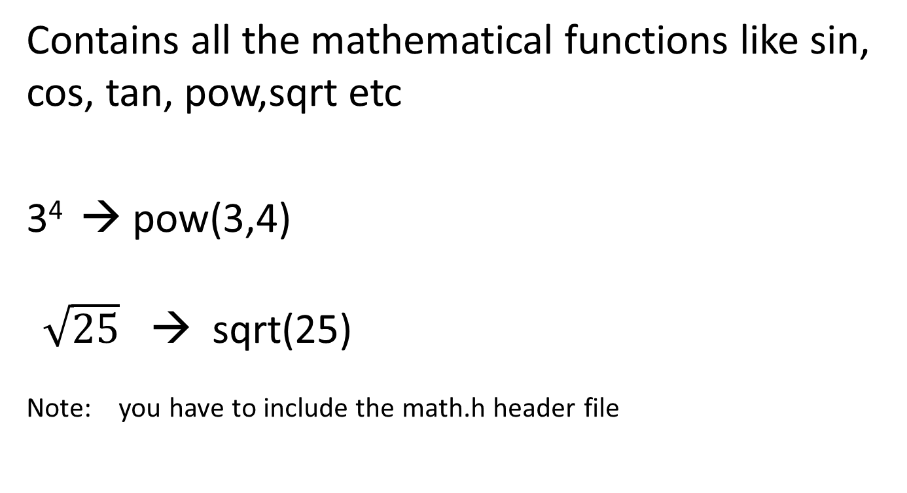
Header file math.h
Contains all the mathematical functions like sin, cos, tan, pow,sqrt etc
3⁴ → pow(3,4)
$\sqrt{25}$ → sqrt(25)
Note: you have to include the math.h header file

Slide 19
// pgm to calculate x²+y²
void main()
{ int x,y,ans;
cout<<“Enter value of x and y”;
cin>>x>>y;
ans= pow(x,2)+pow(y,2);
cout<<“Ans=“<<ans;
getch();
}
// Don’t do cout<<pow(x,2)+pow(y,2) ---- bad pgm

Slide 20
goto statement
makes the flow of control to move from one statement to another
eg:
loop:
stmt1;
stmt2:
condition
goto loop;
else
stmt3;

Slide 21
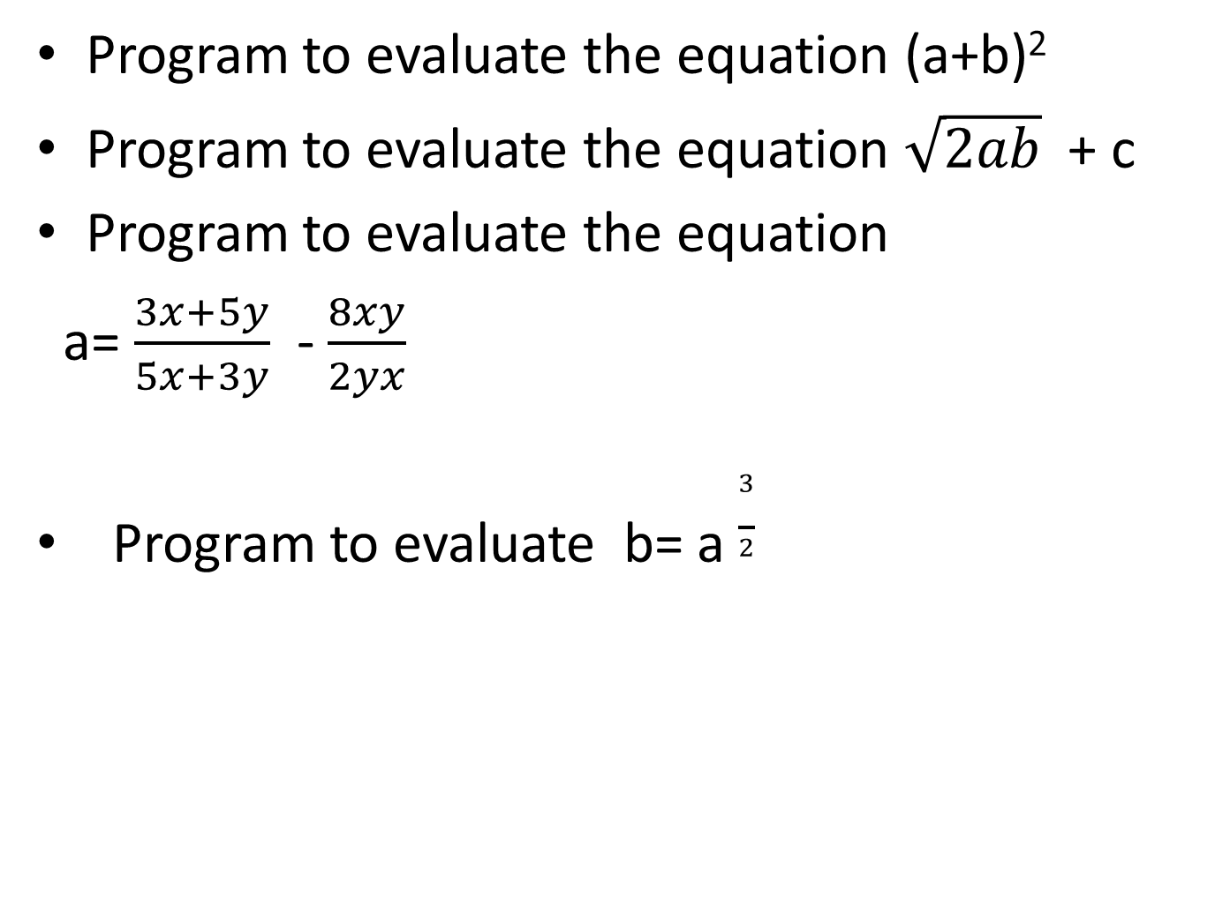
Program to evaluate the equation (a+b)²
Program to evaluate the equation $\sqrt{2ab}$ + c
Program to evaluate the equation
a= $\frac{3x+5y}{5x+3y}$ - $\frac{8xy}{2yx}$
Program to evaluate b= a $\frac{3}{2}$

Slide 22
Program to evaluate the equation
1^{n}+2^{n}+3^{n}+……..X^{n}

Slide 23
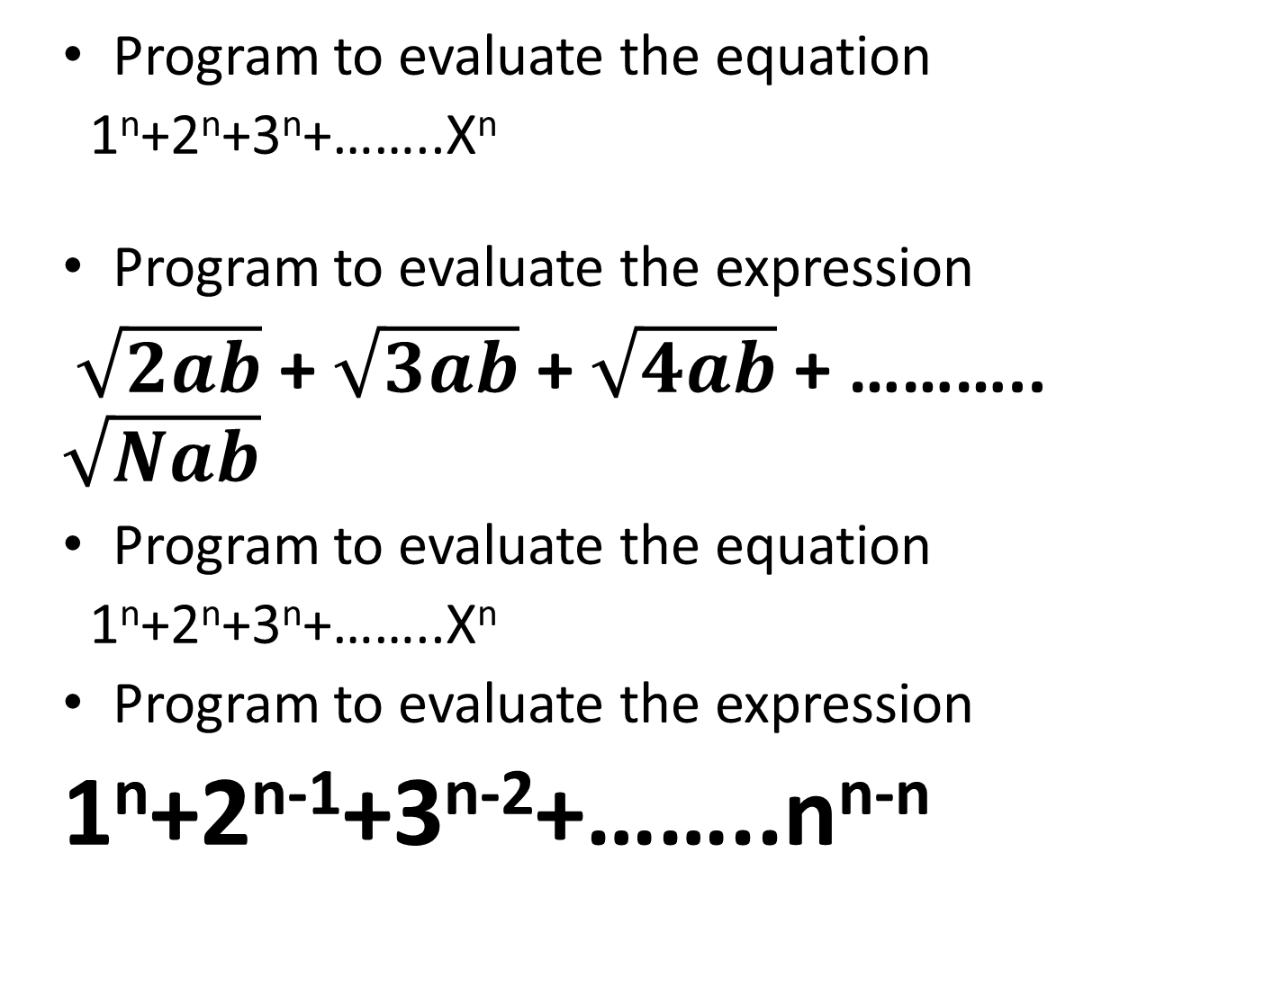
Program to evaluate the equation
1^{n}+2^{n}+3^{n}+……..X^{n}
Program to evaluate the expression
$\sqrt{2ab}$ + $\sqrt{3ab}$ + $\sqrt{4ab}$ + ……….. $\sqrt{Nab}$
Program to evaluate the equation
1^{n}+2^{n}+3^{n}+……..X^{n}
Program to evaluate the expression
1^{n}+2^{n-1}+3^{n-2}+……..n^{n-n}

Slide 24
Class Test

Slide 25
W.AP to read a character and display if it is digit or a special character.
W.A.P to evaluate the expression (x²+y³)⁴
W.A.P to read capital letter and print the same letter in lower case.
Eg Enter a character : F
lower case character is f.
4. W.A.P to insert two numbers and display the greatest of the two numbers by its one’s digit,
Eg Num1 =456
Num 2

Slide 26
FLOWCHART

